Slide 1
Stock Market Indicator Machine LeaRNing
By :
Benjamin Aubry
Gary Fisher
Bruce Mark

Slide 2
Using a Machine learning classification method to predict the direction of the Nikkei (Japanese stock market index)

Slide 3
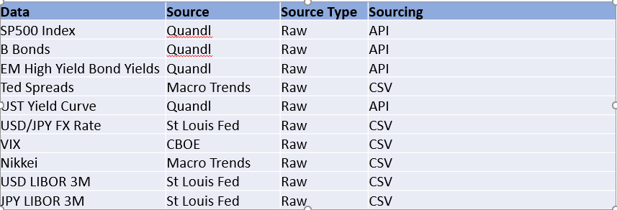
A look at the Japanese stock market
Financial time series forecasting is one of the hardest task given that they usually follow a non-deterministic process but rather a stochastic process (mostly random).
Project Overview
My main goal was to use a Supervised Machine Learning approach to try to predict the direction of the Japanese Stock Market Index (Logistic Regression)
Focus was on classification models
Various market data type was used for the analysis

Slide 4
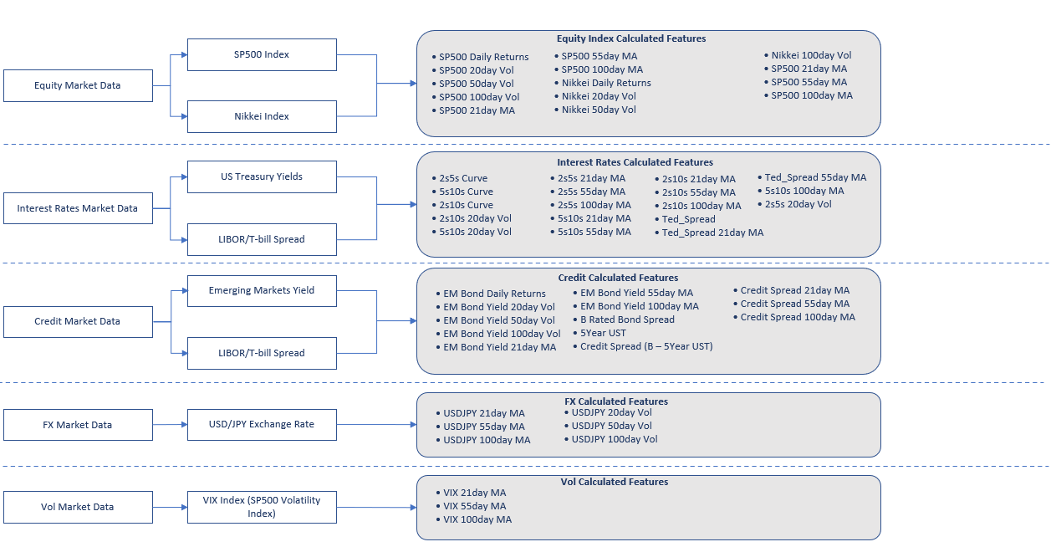
DATA PIPELINE/FEATURE ENGINEERING

Slide 5
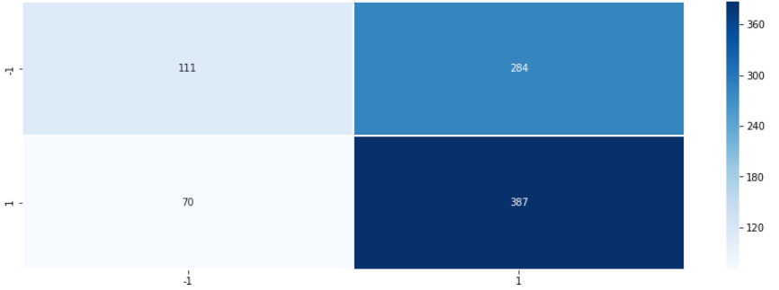
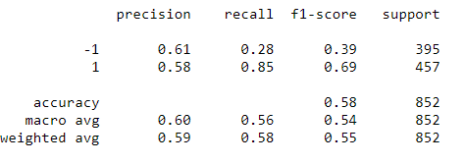
LogiSTIC REGRESSION – feeding all data (Raw + ENGINEERED)
Using all previous features to predict (raw data + feature engineering)
Defined a simple trend-following trading strategy such as buy the market (the next day’s open) if today’s close is higher than yesterday’s close.
The assumption behind this strategy is that the market trend will continue
We define the signal (dependent variable) as y(t) = 1 if today’s close > yesterday’s close or -1 (if less)
Training/Testing data sets have about 3400/850 data points each respectively (75/25 distribution)
Confusion Matrix Results:
• Overall, the model predicts the long/short classes with an accuracy of 59%
• Buy trading signals account for 77% of the correct signals predicted
• Low performance of Sell signals relative to Buy signals with a high score on the False Negative side
Best Features Coefficients:
• SP500 Returns: 0.785
• USDJPY: 0.121
• VIX 21day MA: 0.0585

Slide 6
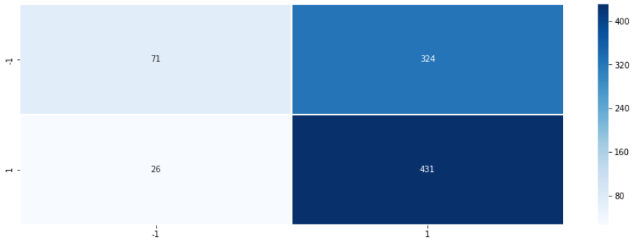
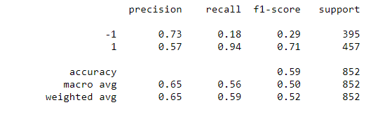
LogiSTIC REGRESSION – Best selected features FROM PREVIOUS MODEL
Building on the previous model, decided to model the signal as a function of the below 3 variables:
SP500 Returns
USDJPY FX Rate
VIX 21day Moving Average
Confusion Matrix Results:
• Overall, the accuracy is the same as the previous model (the one with all the data)
• Higher True Positives but also higher False Negatives
• Adding more data to the model proved to be adding noise instead of value.
• Ability to get a similar score with model containing 3 features instead of 59 !!!

Slide 7
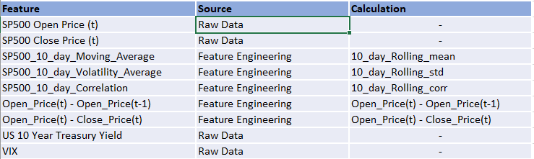
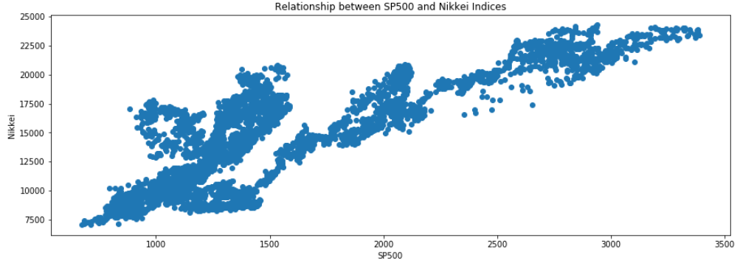
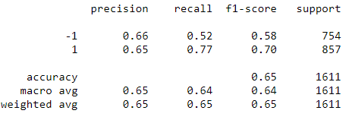
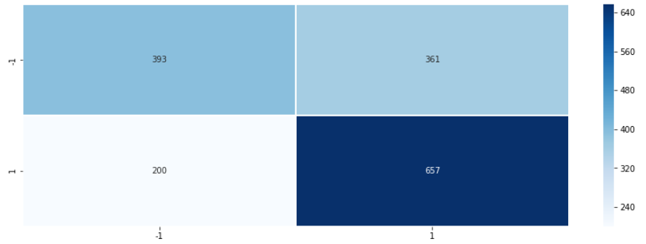
LogiSTIC REGRESSION – ADDING short time indicators
Using domain knowledge and intuition, the below features were used to train this version of the model:
The Nikkei and the S&P500 are highly correlated (the S&P usually acts as the main driver of global stock markets)
• Shorter term indicators used as inputs (shorter Moving Averages, correlation and Intraday data)
• Different training/testing periods were used (shorter training/longer testing)
Confusion Matrix Results:
• Overall, the total accuracy improves compared to the previous models (65% Probability)
• Shorter term indicators capture also tend to improve the Sell signals (number of True Negatives slightly higher than False Negatives)

Slide 8
Promising, but….
While there seems to be some prediction capabilities using certain market data points, it is important to mention that before using such a model in a production environment, a full back test including transaction costs would be required.
Models that worked using past data do not necessarily work in the future (markets constantly change…)
The analysis revealed that Buy signals were generated with consistency. I would add a caveat to that given that markets have been in a significant up-trend since the lows of the global Financial Crisis back in 2009.
Improvements:
While there is some positive, more granular data would be needed (i.e. intraday data)
Imagination is the limit, new data sets could be used and combined to produce alpha
Finally, training a Neural Network would be worth testing.

Slide 9
Primary Question: Can Machine Learning be utilized to gain an advantage while trading the S&P 500 two-month futures contracts?
Multiple financial datasets and ratios were analyzed and compared in order to predict trends and determine appropriate trading range tranches.
Data Sources from Quandl API:
US Treasury Yield Curve Daily
S&P 500 2-Month Futures Daily
S&P 500 Monthly Dividend Yield
Data Rows (Data Since June 22nd 1998):
Training: 4278 (79.6%)
Testing: 1099 (20.4%)
Data Features (Columns):
Original Number: 20
Selected for Model: 9
Machine Learning Models:
Tested: Multi-Linear Regression
K-Nearest Neighbors (KNN)
Random Forest
Selected: K-Nearest Neighbors (KNN)
Type: Classification
RSI
SP500 corr 6Mo-3Mo % Ret
Div/10Yr-2Yr
12WMA%12EMA
12WMA%26EMA
12EMA%26EMA
50SMA%100SMA
50SMA%200SMA
100SMA%200SMA
SP500%12WMA
SP500%12EMA
SP500%26EMA
SP500%50SMA
SP500%100SMA
SP500%200SMA
SP500%3Upper
SP500%2Upper
SP500%Middle20Day
SP500%2Lower
SP500%3Lower

Slide 10
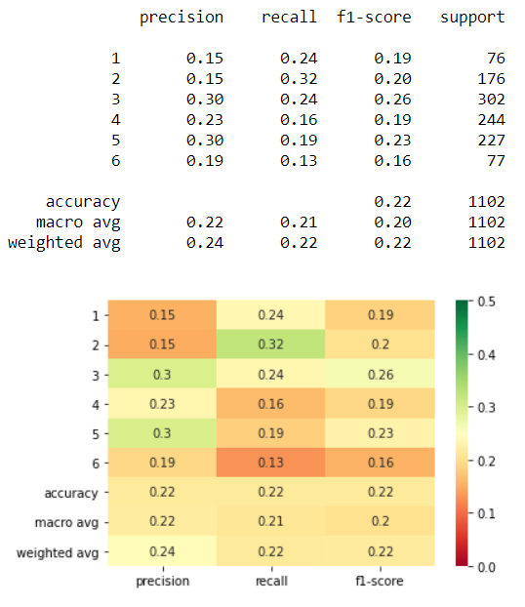
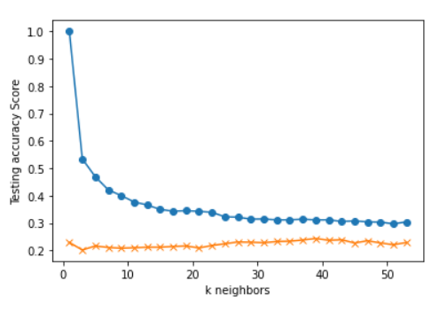

Criteria:
S&P 500 Day(s) Forward Return: 1
Number of Return Percentile Bins: 6
1: Lowest 10% Returns Below -1.30%
2: 10% to 30% Between -1.30% and -0.32%
3: 30% to 50% Between -0.32% and 0.06%
4: 50% to 70% Between 0.06% and 0.46%
5: 70% to 90% Between 0.46% and 1.27%
6: Highest 10% Returns Above 1.27%
X-Feature Inputs: K Neighbors: 39
12WMA%12EMA
12WMA%26EMA
12EMA%26EMA
50SMA%100SMA
50SMA%200SMA
100SMA%200SMA
RSI
SP500 corr 6Mo-3Mo % Ret
Div/10Yr-2Yr
SP500%12WMA
SP500%12EMA
SP500%26EMA
SP500%50SMA
SP500%100SMA
SP500%200SMA
SP500%3Upper
SP500%2Upper
SP500%Middle20Day
SP500%2Lower
SP500%3Lower

Slide 11
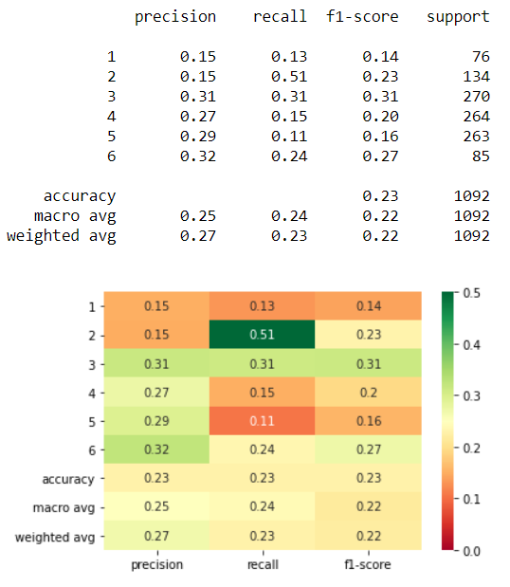
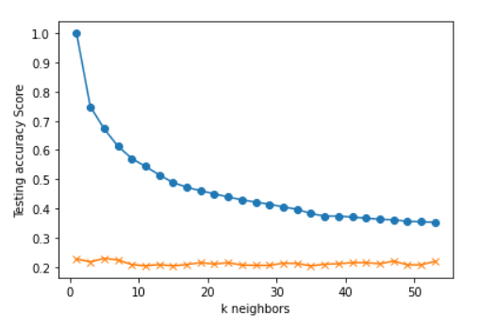
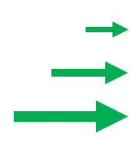
Criteria:
S&P 500 Day(s) Forward Return: 10
Number of Return Percentile Bins: 6
1: Lowest 10% Returns Below -3.69%
2: 10% to 30% Between -3.69% and -0.88%
3: 30% to 50% Between -0.88% and 0.54%
4: 50% to 70% Between 0.54% and 1.73%
5: 70% to 90% Between 1.73% and 3.73%
6: Highest 10% Returns Above 3.73%
X-Feature Inputs: K Neighbors: 5
12WMA%12EMA
12WMA%26EMA
12EMA%26EMA
50SMA%100SMA
50SMA%200SMA
100SMA%200SMA
RSI
SP500 corr 6Mo-3Mo % Ret
Div/10Yr-2Yr
SP500%12WMA
SP500%12EMA
SP500%26EMA
SP500%50SMA
SP500%100SMA
SP500%200SMA
SP500%3Upper
SP500%2Upper
SP500%Middle20Day
SP500%2Lower
SP500%3Lower

Slide 12
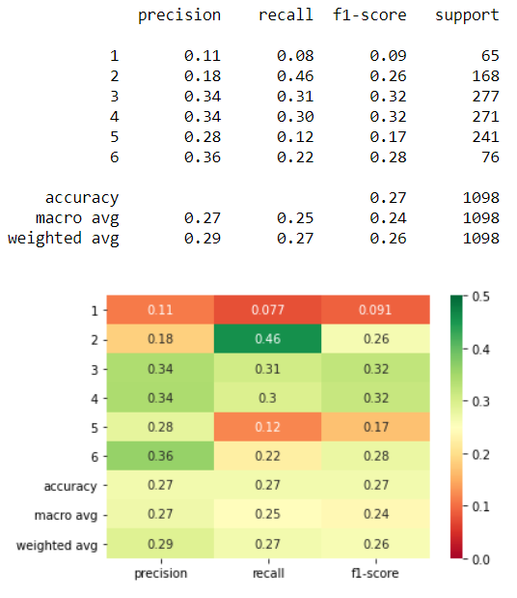
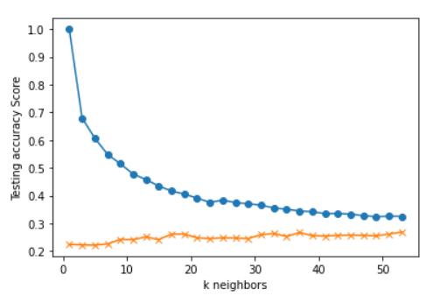
Criteria:
S&P 500 Day(s) Forward Return: 5
Number of Return Percentile Bins: 6
1: Lowest 10% Returns Below -2.78%
2: 10% to 30% Between -2.78% and -0.70%
3: 30% to 50% Between -0.70% and 0.29%
4: 50% to 70% Between 0.29% and 1.19%
5: 70% to 90% Between 1.19% and 2.70%
6: Highest 10% Returns Above 2.70%
X-Feature Inputs: K Neighbors: 37
12WMA%12EMA
12WMA%26EMA
12EMA%26EMA
50SMA%100SMA
50SMA%200SMA
100SMA%200SMA
RSI
SP500 corr 6Mo-3Mo % Ret
Div/10Yr-2Yr
SP500%12WMA
SP500%12EMA
SP500%26EMA
SP500%50SMA
SP500%100SMA
SP500%200SMA
SP500%3Upper
SP500%2Upper
SP500%Middle20Day
SP500%2Lower
SP500%3Lower

Slide 13
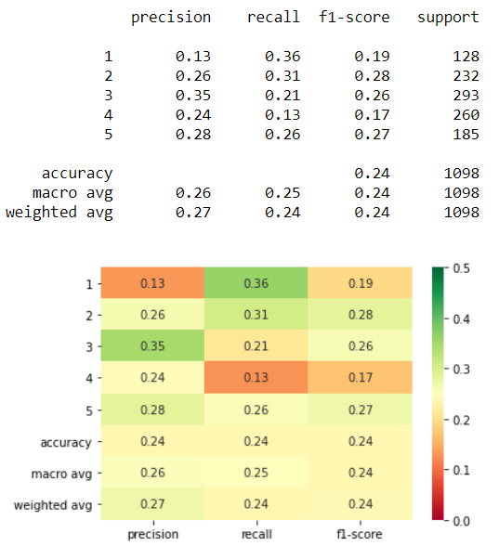
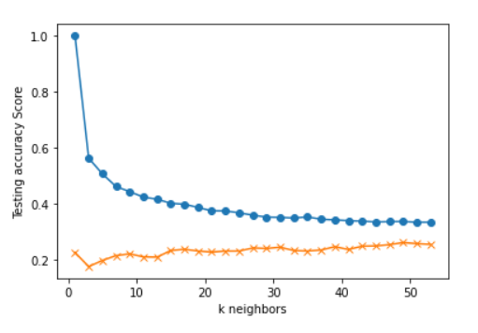
Criteria:
S&P 500 Day(s) Forward Return: 5
Number of Return Percentile Bins: 5
1: Lowest 20% Returns Below -1.47%
2: 20% to 40% Between -1.47% and -0.14%
3: 40% to 60% Between -0.14% and 0.72%
4: 60% to 80% Between 0.72% and 1.74%
5: Highest 20% Returns Above 1.74%
X-Feature Inputs: K Neighbors: 17
12WMA%12EMA
12WMA%26EMA
12EMA%26EMA
50SMA%100SMA
50SMA%200SMA
100SMA%200SMA
RSI
SP500 corr 6Mo-3Mo % Ret
Div/10Yr-2Yr
SP500%12WMA
SP500%12EMA
SP500%26EMA
SP500%50SMA
SP500%100SMA
SP500%200SMA
SP500%3Upper
SP500%2Upper
SP500%Middle20Day
SP500%2Lower
SP500%3Lower

Slide 14
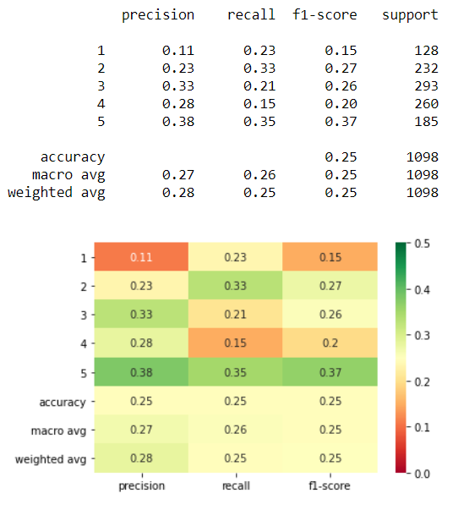
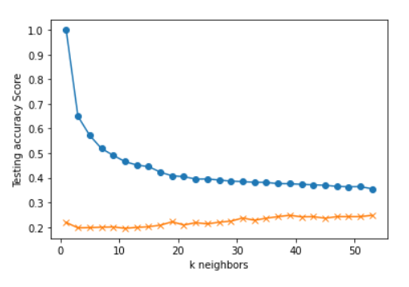
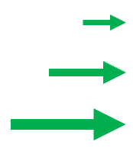
Criteria:
S&P 500 Day(s) Forward Return: 5
Number of Return Percentile Bins: 5
1: Lowest 20% Returns Below -1.47%
2: 20% to 40% Between -1.47% and -0.14%
3: 40% to 60% Between -0.14% and 0.72%
4: 60% to 80% Between 0.72% and 1.74%
5: Highest 20% Returns Above 1.74%
X-Feature Inputs: K Neighbors: 39
12WMA%12EMA
12WMA%26EMA
12EMA%26EMA
50SMA%100SMA
50SMA%200SMA
100SMA%200SMA
RSI
SP500 corr 6Mo-3Mo % Ret
Div/10Yr-2Yr
SP500%12WMA
SP500%12EMA
SP500%26EMA
SP500%50SMA
SP500%100SMA
SP500%200SMA
SP500%3Upper
SP500%2Upper
SP500%Middle20Day
SP500%2Lower
SP500%3Lower

Slide 15
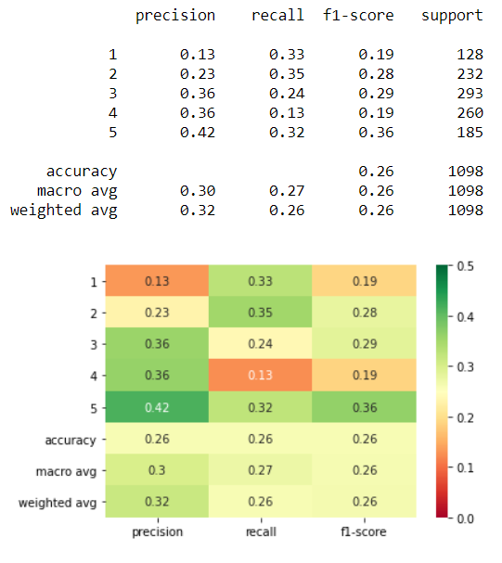
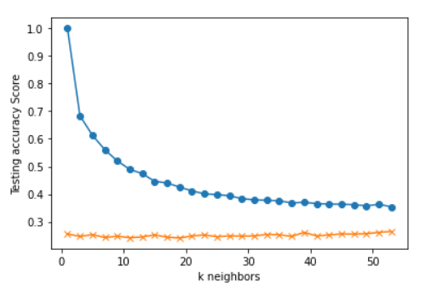
Criteria:
S&P 500 Day(s) Forward Return: 5
Number of Return Percentile Bins: 5
1: Lowest 20% Returns Below -1.47%
2: 20% to 40% Between -1.47% and -0.14%
3: 40% to 60% Between -0.14% and 0.72%
4: 60% to 80% Between 0.72% and 1.74%
5: Highest 20% Returns Above 1.74%
X-Feature Inputs: K Neighbors: 39
12WMA%12EMA
12WMA%26EMA
12EMA%26EMA
50SMA%100SMA
50SMA%200SMA
100SMA%200SMA
RSI
SP500 corr 6Mo-3Mo % Ret
Div/10Yr-2Yr
SP500%12WMA
SP500%12EMA
SP500%26EMA
SP500%50SMA
SP500%100SMA
SP500%200SMA
SP500%3Upper
SP500%2Upper
SP500%Middle20Day
SP500%2Lower
SP500%3Lower

Slide 16
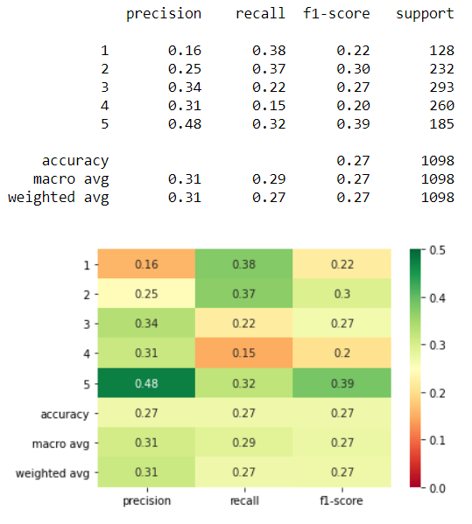
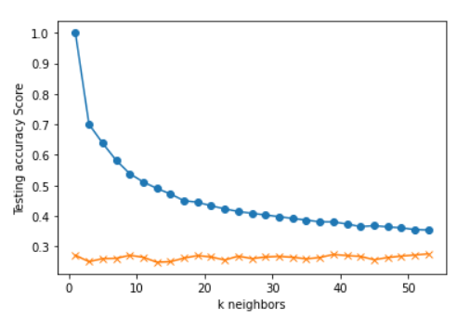
Criteria:
S&P 500 Day(s) Forward Return: 5
Number of Return Percentile Bins: 5
1: Lowest 20% Returns Below -1.47%
2: 20% to 40% Between -1.47% and -0.14%
3: 40% to 60% Between -0.14% and 0.72%
4: 60% to 80% Between 0.72% and 1.74%
5: Highest 20% Returns Above 1.74%
X-Feature Inputs: K Neighbors: 9
12WMA%12EMA
12WMA%26EMA
12EMA%26EMA
50SMA%100SMA
50SMA%200SMA
100SMA%200SMA
RSI
SP500 corr 6Mo-3Mo % Ret
Div/10Yr-2Yr
SP500%12WMA
SP500%12EMA
SP500%26EMA
SP500%50SMA
SP500%100SMA
SP500%200SMA
SP500%3Upper
SP500%2Upper
SP500%Middle20Day
SP500%2Lower
SP500%3Lower

Slide 17
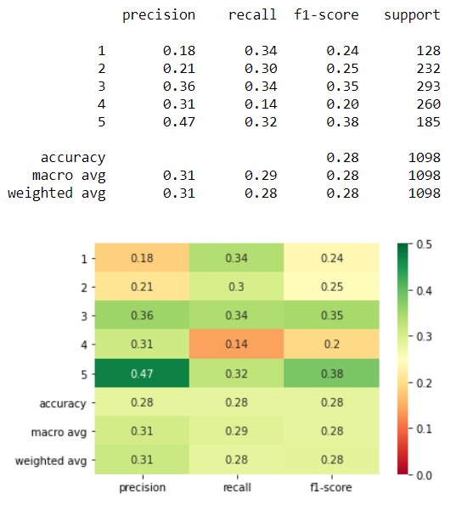
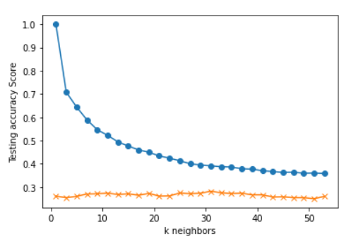
Criteria:
S&P 500 Day(s) Forward Return: 5
Number of Return Percentile Bins: 5
1: Lowest 20% Returns Below -1.47%
2: 20% to 40% Between -1.47% and -0.14%
3: 40% to 60% Between -0.14% and 0.72%
4: 60% to 80% Between 0.72% and 1.74%
5: Highest 20% Returns Above 1.74%
X-Feature Inputs: K Neighbors: 31
12WMA%12EMA
12WMA%26EMA
12EMA%26EMA
50SMA%100SMA
50SMA%200SMA
100SMA%200SMA
RSI
SP500 corr 6Mo-3Mo % Ret
Div/10Yr-2Yr
SP500%12WMA
SP500%12EMA
SP500%26EMA
SP500%50SMA
SP500%100SMA
SP500%200SMA
SP500%3Upper
SP500%2Upper
SP500%Middle20Day
SP500%2Lower
SP500%3Lower

Slide 18
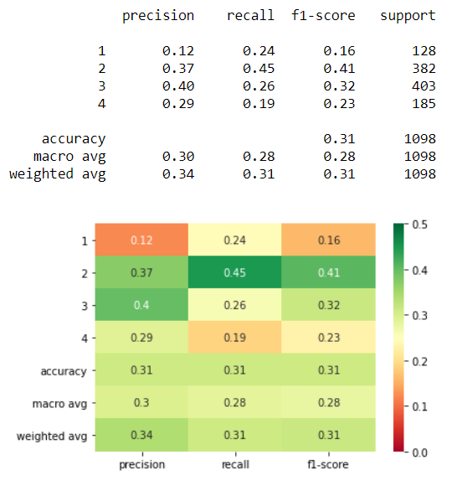
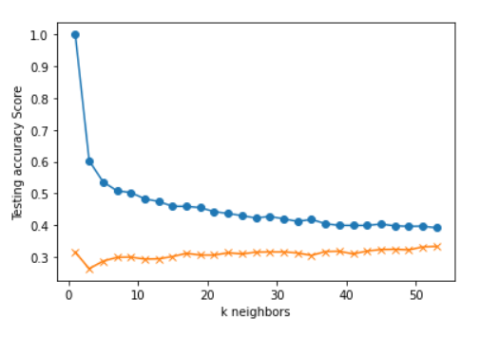
Criteria:
S&P 500 Day(s) Forward Return: 5
Number of Return Percentile Bins: 4
1: Lowest 20% Returns Below -1.47%
2: 20% to 50% Between -1.47% and 0.29%
3: 50% to 80% Between 0.29% and 1.74%
4: Highest 20% Returns Above 1.74%
X-Feature Inputs: K Neighbors: 17
12WMA%12EMA
12WMA%26EMA
12EMA%26EMA
50SMA%100SMA
50SMA%200SMA
100SMA%200SMA
RSI
SP500 corr 6Mo-3Mo % Ret
Div/10Yr-2Yr
SP500%12WMA
SP500%12EMA
SP500%26EMA
SP500%50SMA
SP500%100SMA
SP500%200SMA
SP500%3Upper
SP500%2Upper
SP500%Middle20Day
SP500%2Lower
SP500%3Lower

Slide 19
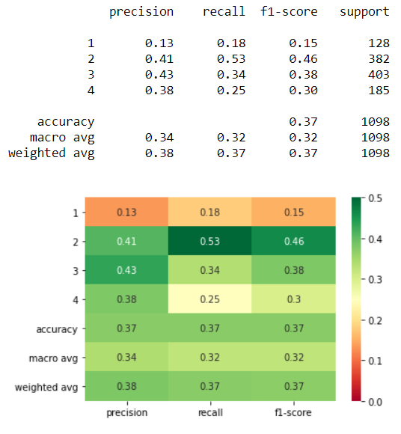
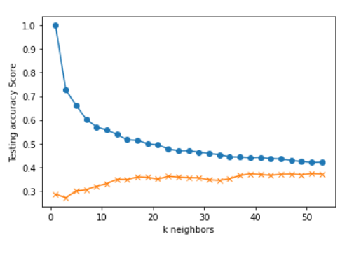
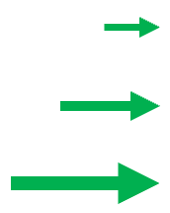
Criteria:
S&P 500 Day(s) Forward Return: 5
Number of Return Percentile Bins: 4
1: Lowest 20% Returns Below -1.47%
2: 20% to 50% Between -1.47% and 0.29%
3: 50% to 80% Between 0.29% and 1.74%
4: Highest 20% Returns Above 1.74%
X-Feature Inputs: K Neighbors: 39
12WMA%12EMA
12WMA%26EMA
12EMA%26EMA
50SMA%100SMA
50SMA%200SMA
100SMA%200SMA
RSI
SP500 corr 6Mo-3Mo % Ret
Div/10Yr-2Yr
SP500%12WMA
SP500%12EMA
SP500%26EMA
SP500%50SMA
SP500%100SMA
SP500%200SMA
SP500%3Upper
SP500%2Upper
SP500%Middle20Day
SP500%2Lower
SP500%3Lower

Slide 20
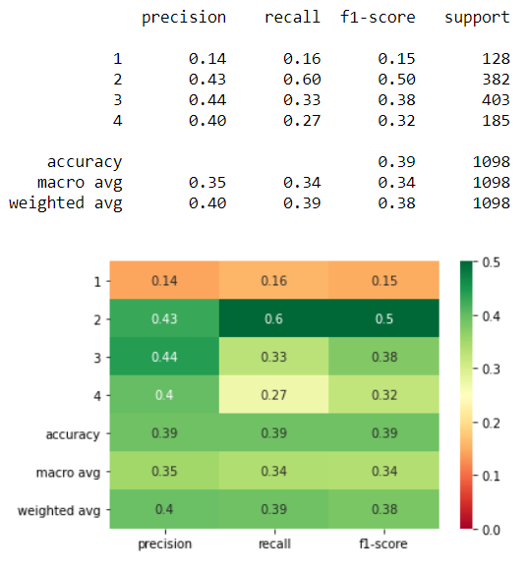
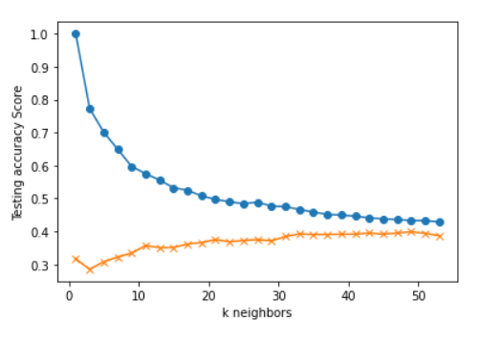
Criteria:
S&P 500 Day(s) Forward Return: 5
Number of Return Percentile Bins: 4
1: Lowest 20% Returns Below -1.47%
2: 20% to 50% Between -1.47% and 0.29%
3: 50% to 80% Between 0.29% and 1.74%
4: Highest 20% Returns Above 1.74%
X-Feature Inputs: K Neighbors: 33
12WMA%12EMA
12WMA%26EMA
12EMA%26EMA
50SMA%100SMA
50SMA%200SMA
100SMA%200SMA
RSI
SP500 corr 6Mo-3Mo % Ret
Div/10Yr-2Yr
SP500%12WMA
SP500%12EMA
SP500%26EMA
SP500%50SMA
SP500%100SMA
SP500%200SMA
SP500%3Upper
SP500%2Upper
SP500%Middle20Day
SP500%2Lower
SP500%3Lower

Slide 21
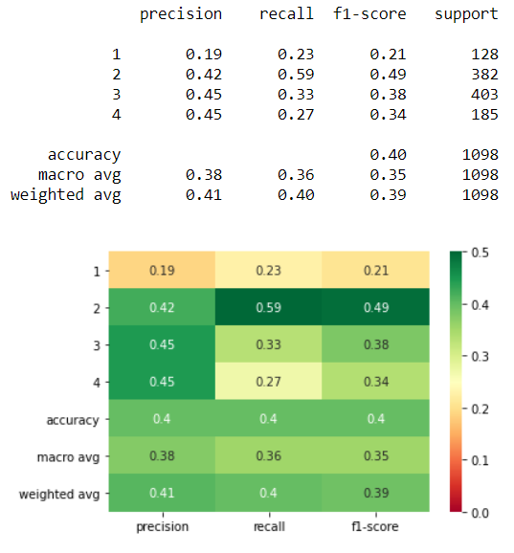
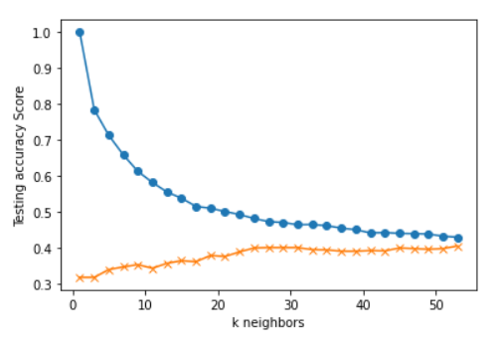
Criteria:
S&P 500 Day(s) Forward Return: 5
Number of Return Percentile Bins: 4
1: Lowest 20% Returns Below -1.47%
2: 20% to 50% Between -1.47% and 0.29%
3: 50% to 80% Between 0.29% and 1.74%
4: Highest 20% Returns Above 1.74%
X-Feature Inputs: K Neighbors: 27
12WMA%12EMA
12WMA%26EMA
12EMA%26EMA
50SMA%100SMA
50SMA%200SMA
100SMA%200SMA
RSI
SP500 corr 6Mo-3Mo % Ret
Div/10Yr-2Yr
SP500%12WMA
SP500%12EMA
SP500%26EMA
SP500%50SMA
SP500%100SMA
SP500%200SMA
SP500%3Upper
SP500%2Upper
SP500%Middle20Day
SP500%2Lower
SP500%3Lower

Slide 22
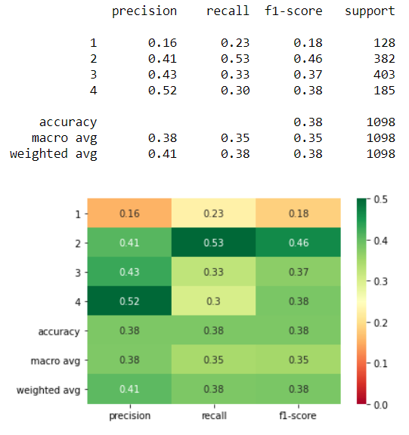
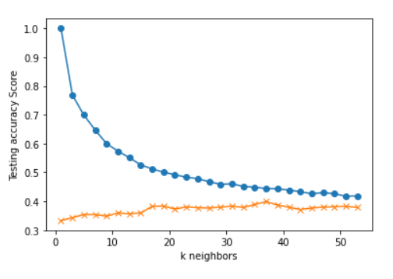
Criteria:
S&P 500 Day(s) Forward Return: 5
Number of Return Percentile Bins: 4
1: Lowest 20% Returns Below -1.47%
2: 20% to 50% Between -1.47% and 0.29%
3: 50% to 80% Between 0.29% and 1.74%
4: Highest 20% Returns Above 1.74%
X-Feature Inputs: K Neighbors: 37
12WMA%12EMA
12WMA%26EMA
12EMA%26EMA
50SMA%100SMA
50SMA%200SMA
100SMA%200SMA
RSI
SP500 corr 6Mo-3Mo % Ret
Div/10Yr-2Yr
SP500%12WMA
SP500%12EMA
SP500%26EMA
SP500%50SMA
SP500%100SMA
SP500%200SMA
SP500%3Upper
SP500%2Upper
SP500%Middle20Day
SP500%2Lower
SP500%3Lower

Slide 23
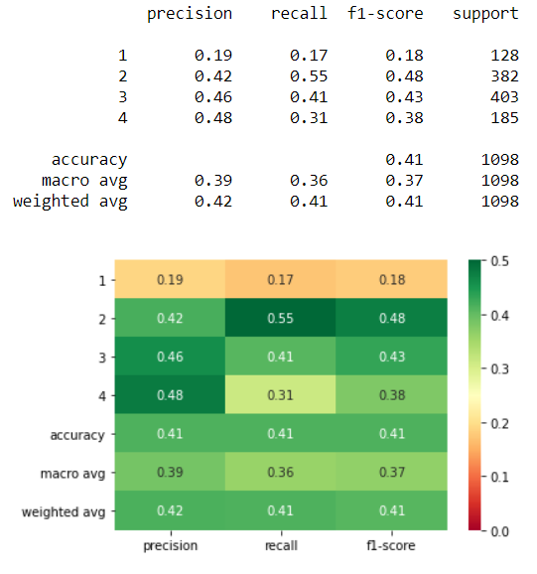
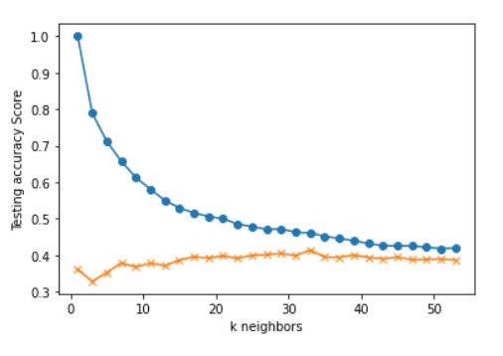
Criteria:
S&P 500 Day(s) Forward Return: 5
Number of Return Percentile Bins: 4
1: Lowest 20% Returns Below -1.47%
2: 20% to 50% Between -1.47% and 0.29%
3: 50% to 80% Between 0.29% and 1.74%
4: Highest 20% Returns Above 1.74%
X-Feature Inputs: K Neighbors: 33
12WMA%12EMA
12WMA%26EMA
12EMA%26EMA
50SMA%100SMA
50SMA%200SMA
100SMA%200SMA
RSI
SP500 corr 6Mo-3Mo % Ret
Div/10Yr-2Yr
SP500%12WMA
SP500%12EMA
SP500%26EMA
SP500%50SMA
SP500%100SMA
SP500%200SMA
SP500%3Upper
SP500%2Upper
SP500%Middle20Day
SP500%2Lower
SP500%3Lower

Slide 24
What Does This All Mean?
We want the highest precision possible in order of importance from bin 4 to 1
The top 17% (185/1098) of the S&P 500’s returns are represented by bin 4
When the model predicts an outcome of 4, there is a 48% chance of being correct
These findings are meaningful because there is a better chance than random at correctly predicting when to place a bet while seeking a top ranked return
This model should be used in conjunction with
other metrics while making investment buy
decisions in order to increase likeliness of
greater percent return
Criteria:
S&P 500 Day(s) Forward Return: 5
Number of Return Percentile Bins: 4
1: Lowest 20% Returns Below -1.47%
2: 20% to 50% Between -1.47% and 0.29%
3: 50% to 80% Between 0.29% and 1.74%
4: Highest 20% Returns Above 1.74%

Slide 25
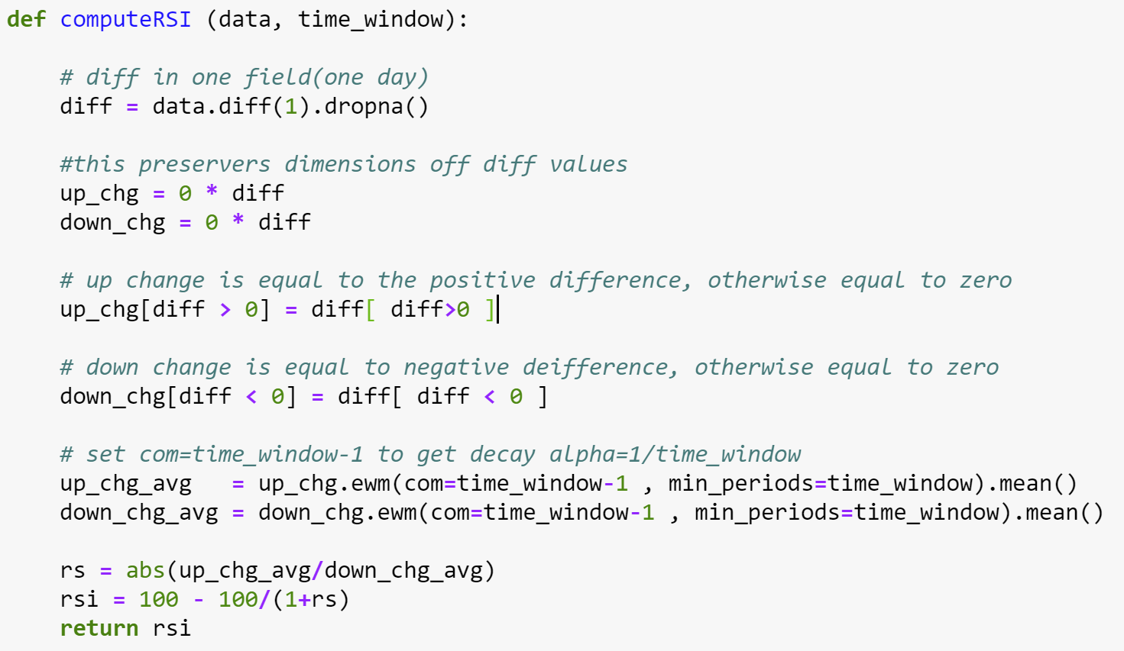
Appendix
RSI (Relative Strength Index):
SP500 corr 6Mo-3Mo % Ret: Correlation between the daily return of the S&P 500 and the daily return of the 6-Month 3-Month spread
Div/10Yr-2Yr: The S&P 500’s dividend yield divided by the spread between the 10-Year and 2-Year US Treasury rate
12WMA%12EMA: Percent change between the S&P 500’s 12-Day Weighted Moving Average and the S&P 500’s 12-Day Exponential Moving Average
12WMA%26EMA: Percent change between the S&P 500’s 12-Day Weighted Moving Average and the S&P 500’s 26-Day Exponential Moving Average

Slide 26
Appendix
12EMA%26EMA: Percent change between the S&P 500’s 12-Day Exponential Moving Average and the S&P 500’s 26-Day Exponential Moving Average
50SMA%100SMA: Percent change between the S&P 500’s 50-Day Simple Moving Average and the S&P 500’s 100-Day Simple Moving Average
50SMA%200SMA: Percent change between the S&P 500’s 50-Day Simple Moving Average and the S&P 500’s 200-Day Simple Moving Average
100SMA%200SMA: Percent change between the S&P 500’s 100-Day Simple Moving Average and the S&P 500’s 200-Day Simple Moving Average
SP500%12WMA: Percent change between the S&P 500 and the S&P 500’s 12-Day Weighted Moving Average
SP500%12EMA: Percent change between the S&P 500 and the S&P 500’s 12-Day Exponential Moving Average
SP500%26EMA: Percent change between the S&P 500 and the S&P 500’s 26-Day Exponential Moving Average
SP500%50SMA: Percent change between the S&P 500 and the S&P 500’s 50-Day Simple Moving Average
SP500%100SMA: Percent change between the S&P 500 and the S&P 500’s 100-Day Simple Moving Average
SP500%200SMA: Percent change between the S&P 500 and the S&P 500’s 200-Day Simple Moving Average

Slide 27
Appendix
SP500%3Upper: Percent change between the S&P 500 and the S&P 500’s Upper, Third Standard Deviation
SP500%2Upper: Percent change between the S&P 500 and the S&P 500’s Upper, Second Standard Deviation
SP500%Middle20Day: Percent change between the S&P 500 and the S&P 500’s 20-Day Simple Moving Average
SP500%2Lower: Percent change between the S&P 500 and the S&P 500’s Lower, Second Standard Deviation
SP500%3Lower: Percent change between the S&P 500 and the S&P 500’s Lower, Third Standard Deviation

Slide 28
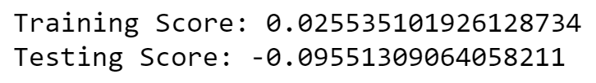
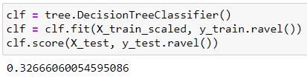
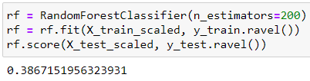
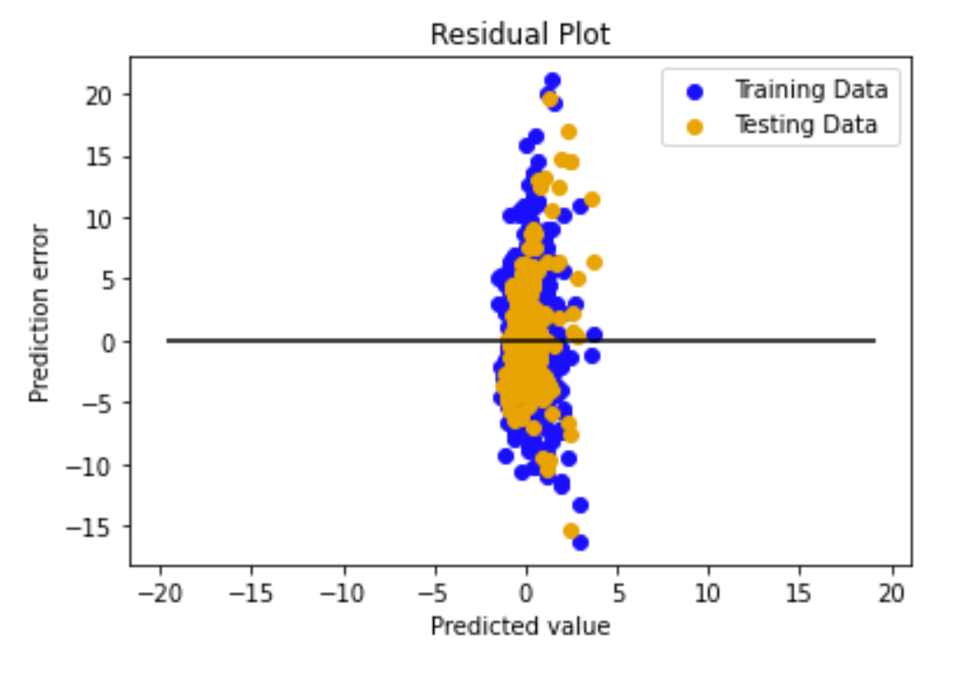
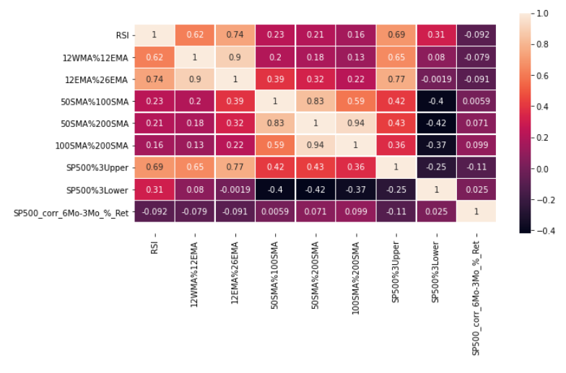
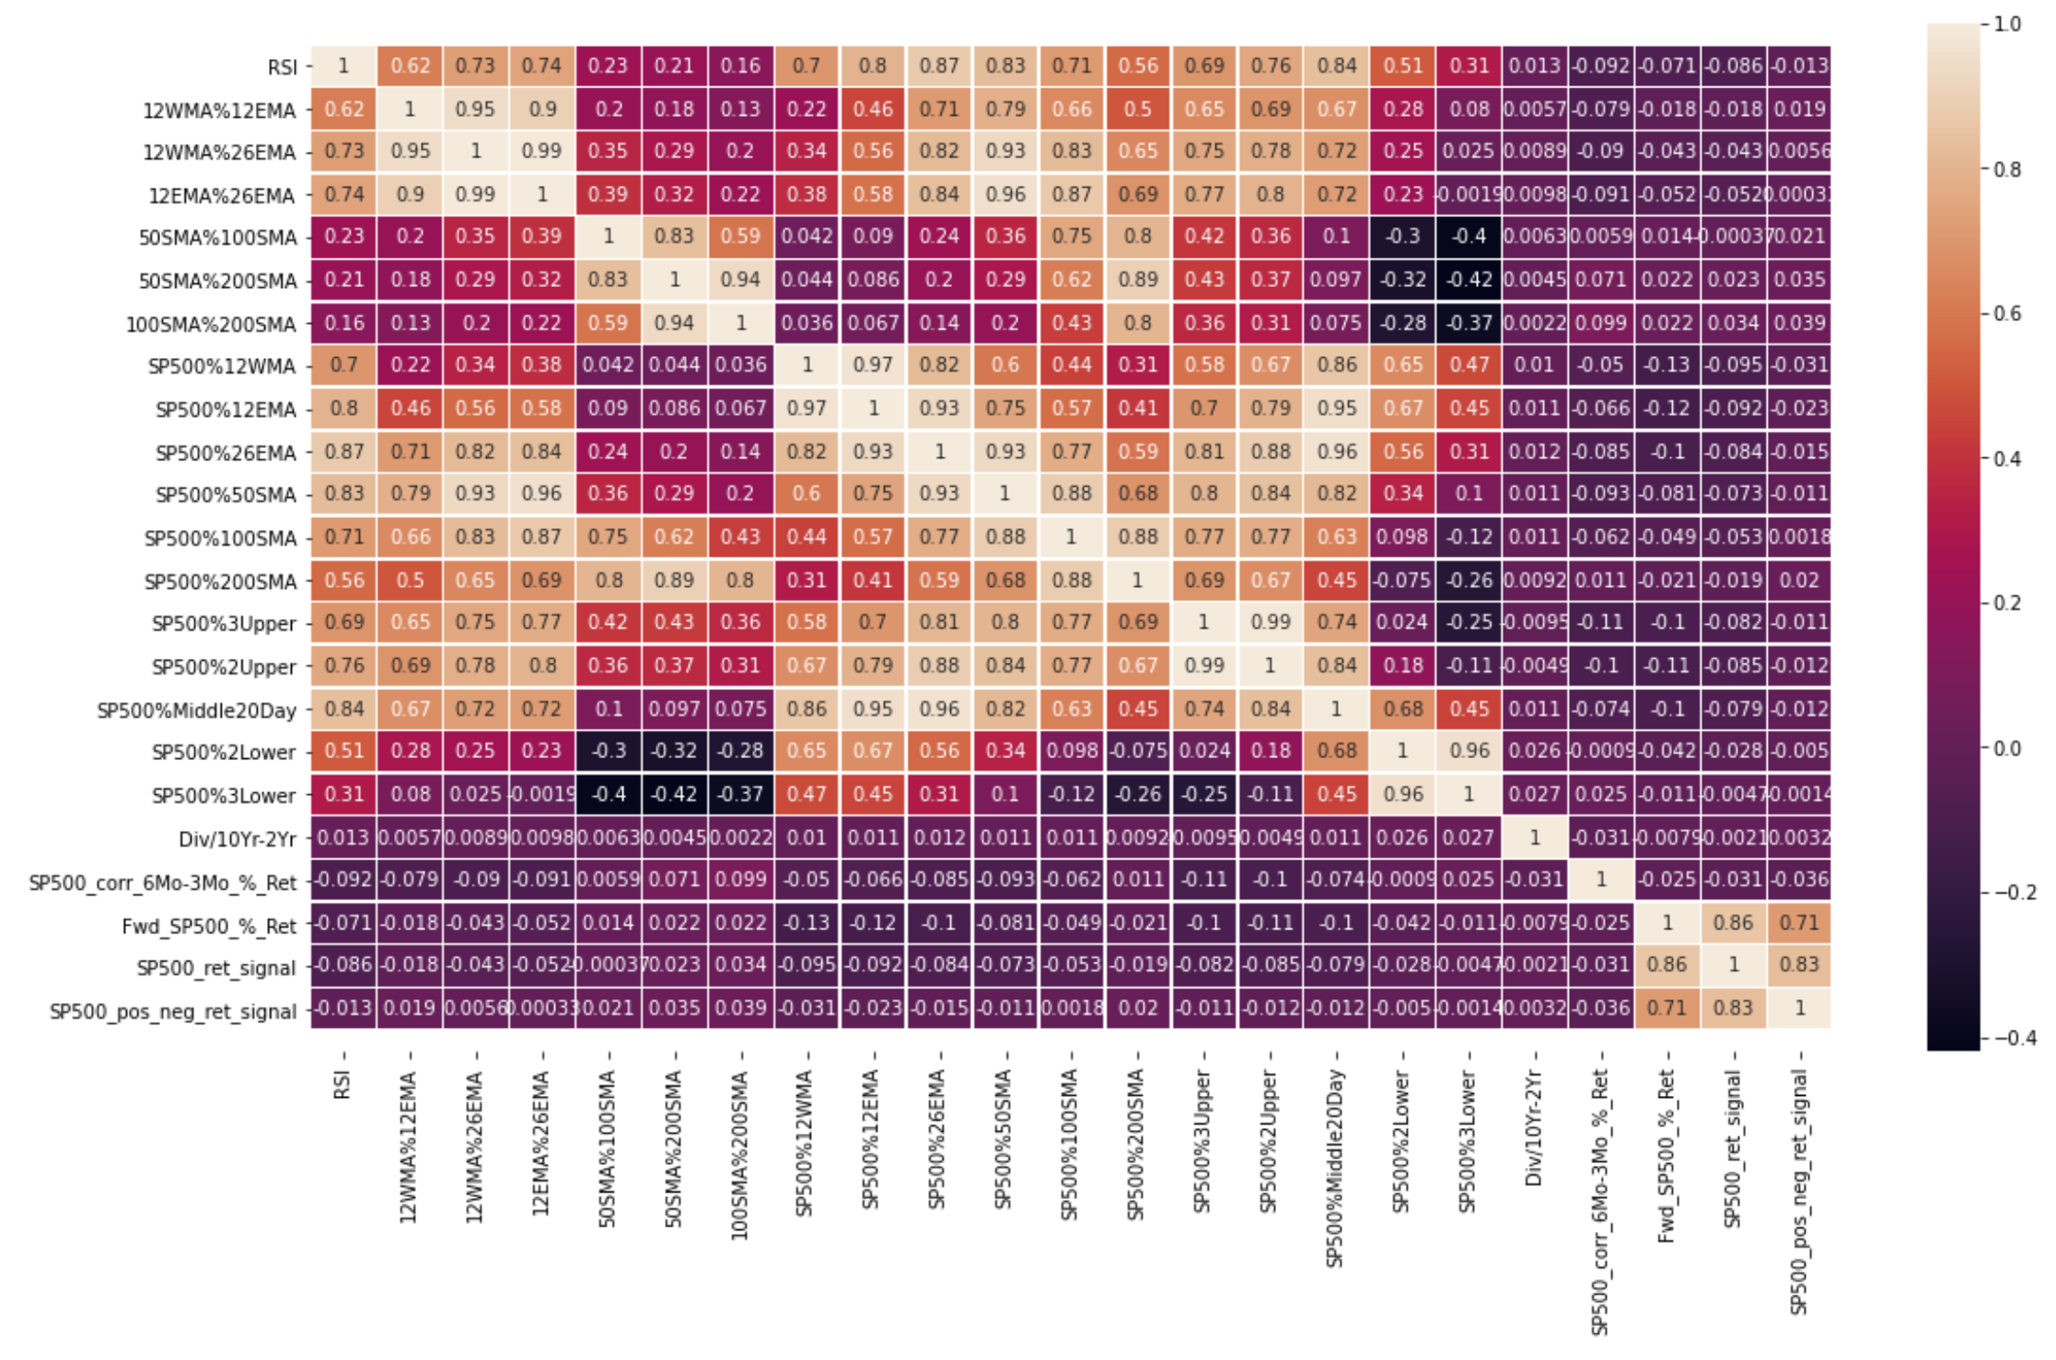
Started with a Regression problem …
Multi-Linear Regression
Random Forest
Feature Correlation Matrix
… having undesirable results …

Slide 29
… and ended with a Classification problem through Discretization …
Feature Correlation Matrix
Classification Report Heatmap
K Neighbors: 37
… having favorable results!

